Slide 1
Seismology, geology and environment
Group 3 weekly project report

Slide 2
Points that we focused on the previous week
Completed and tested earthquake alarm.
Completed and tested shake table.
Completed the documentary
Base isolation for reducing the impact of earthquakes..
Designed the posters.

Slide 3
Points that we will focus on this week
Seismograph
Printing of the posters

Slide 4
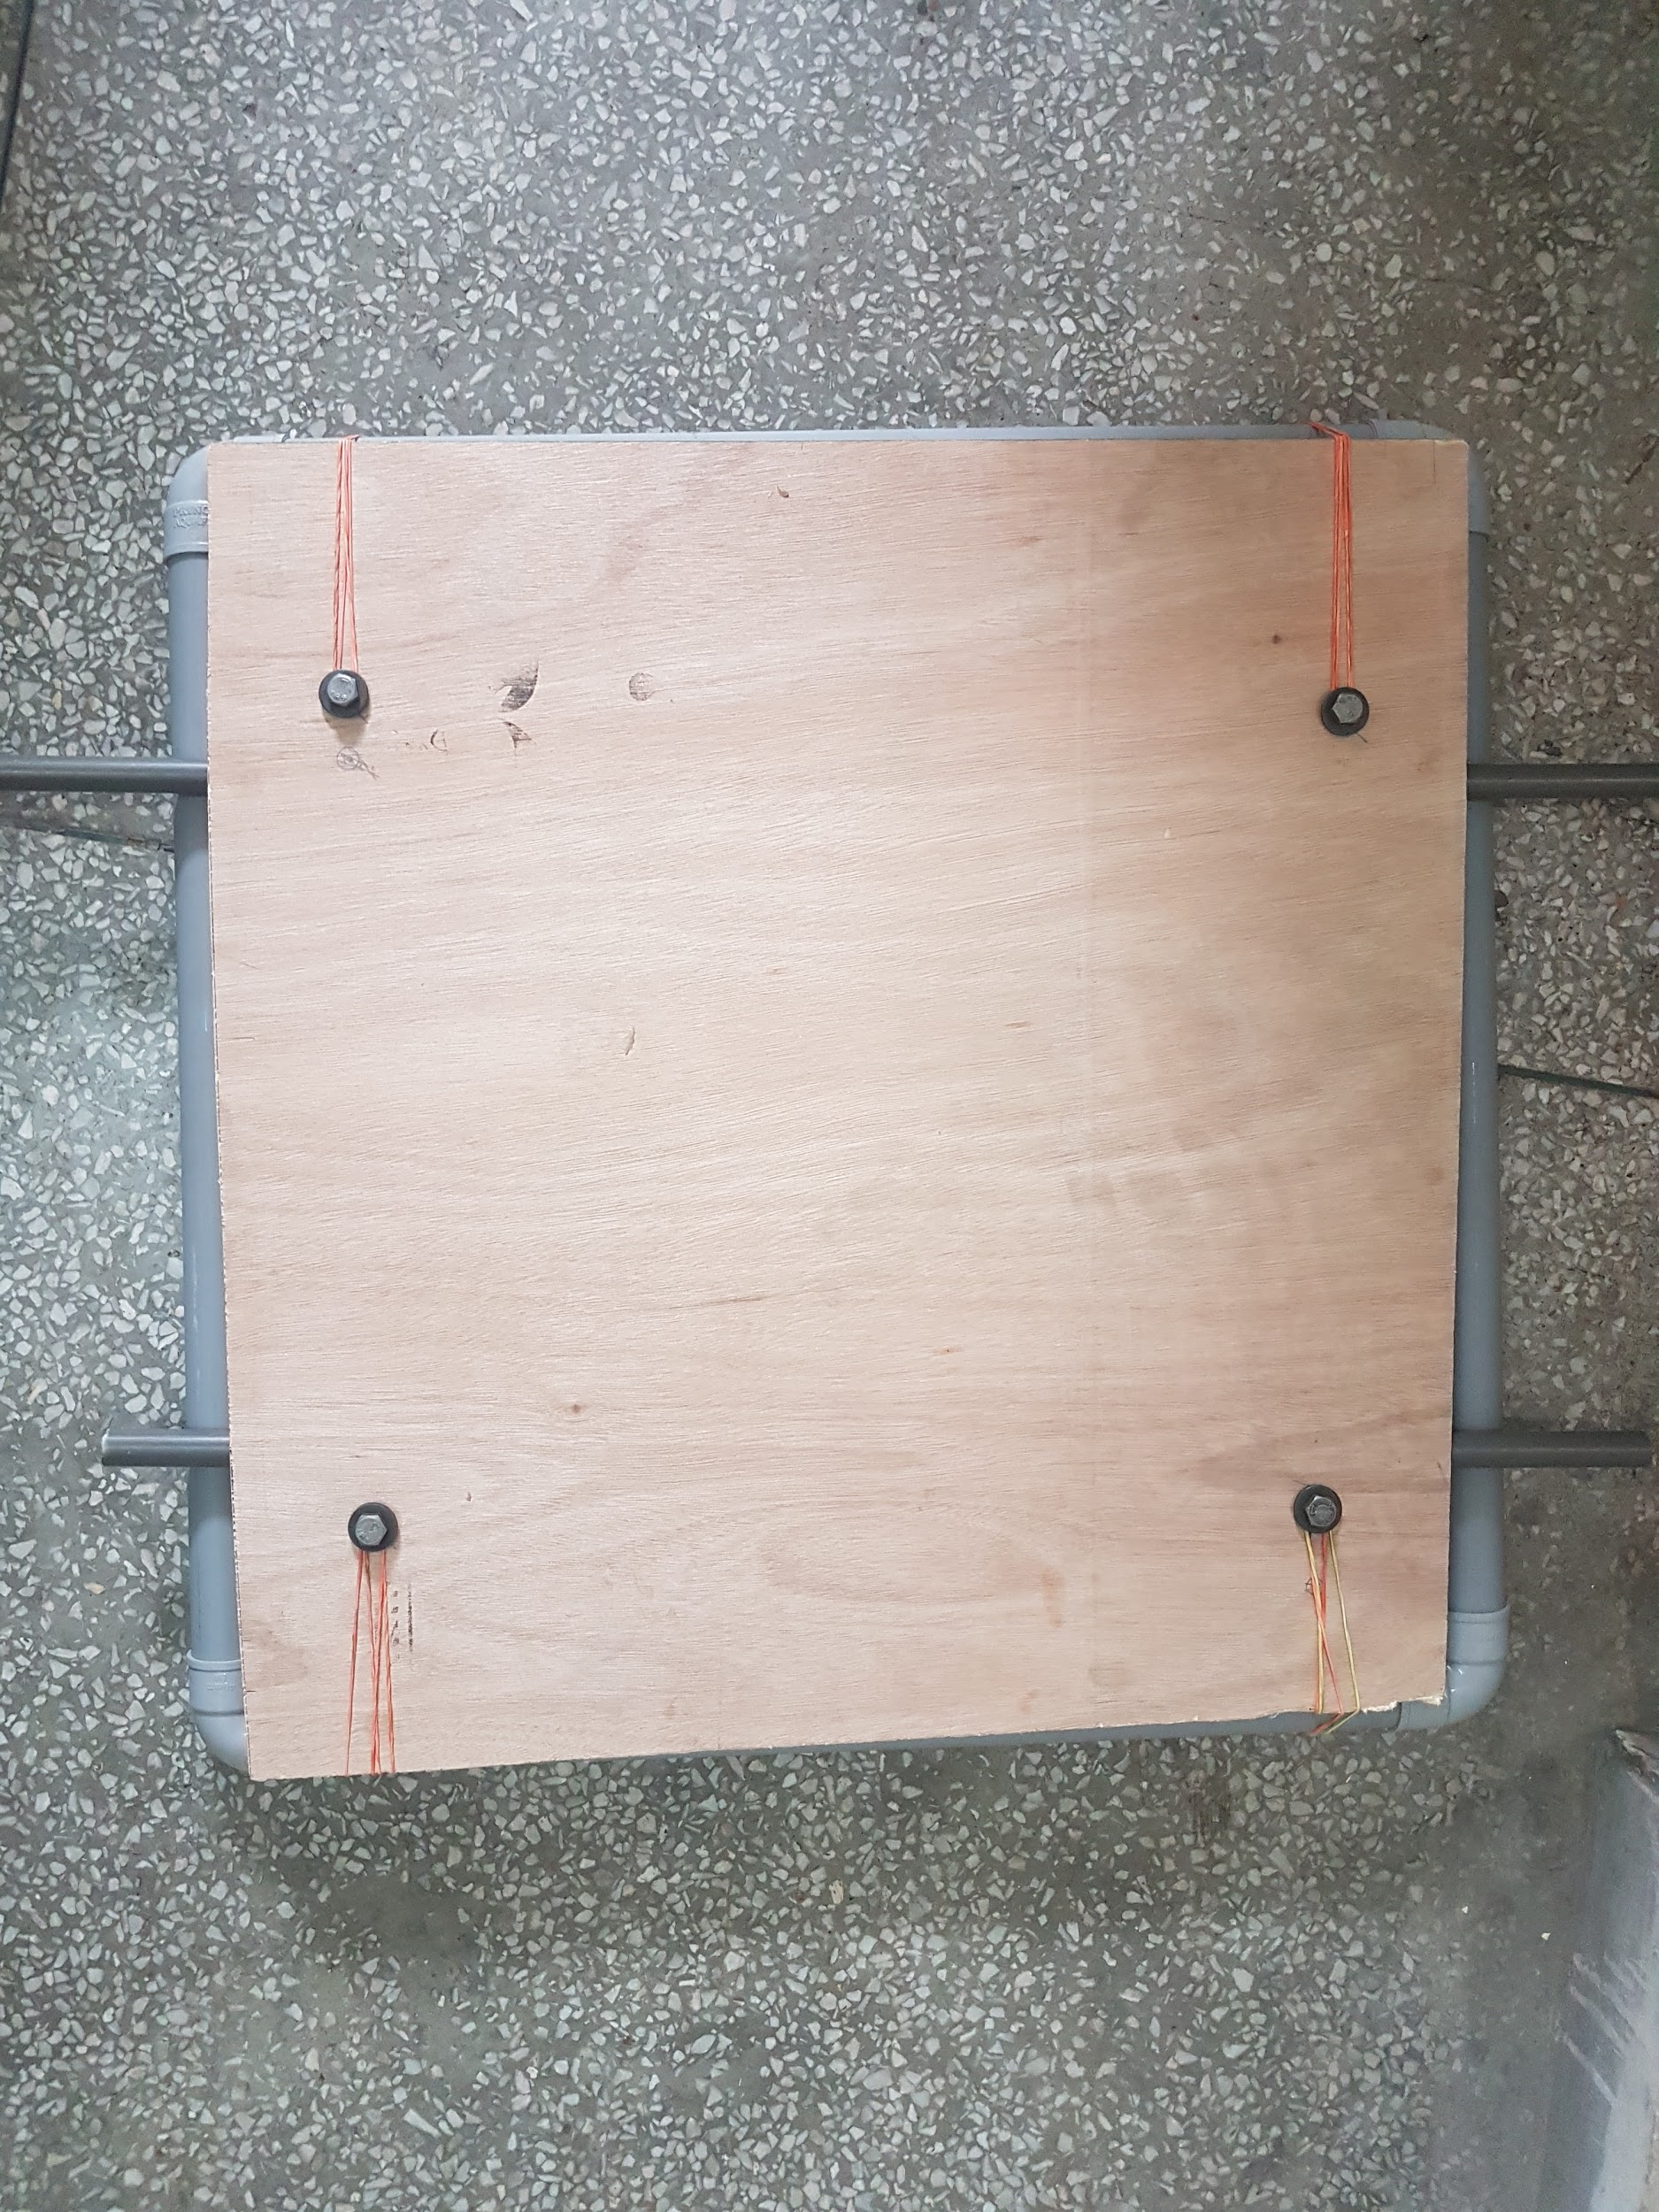
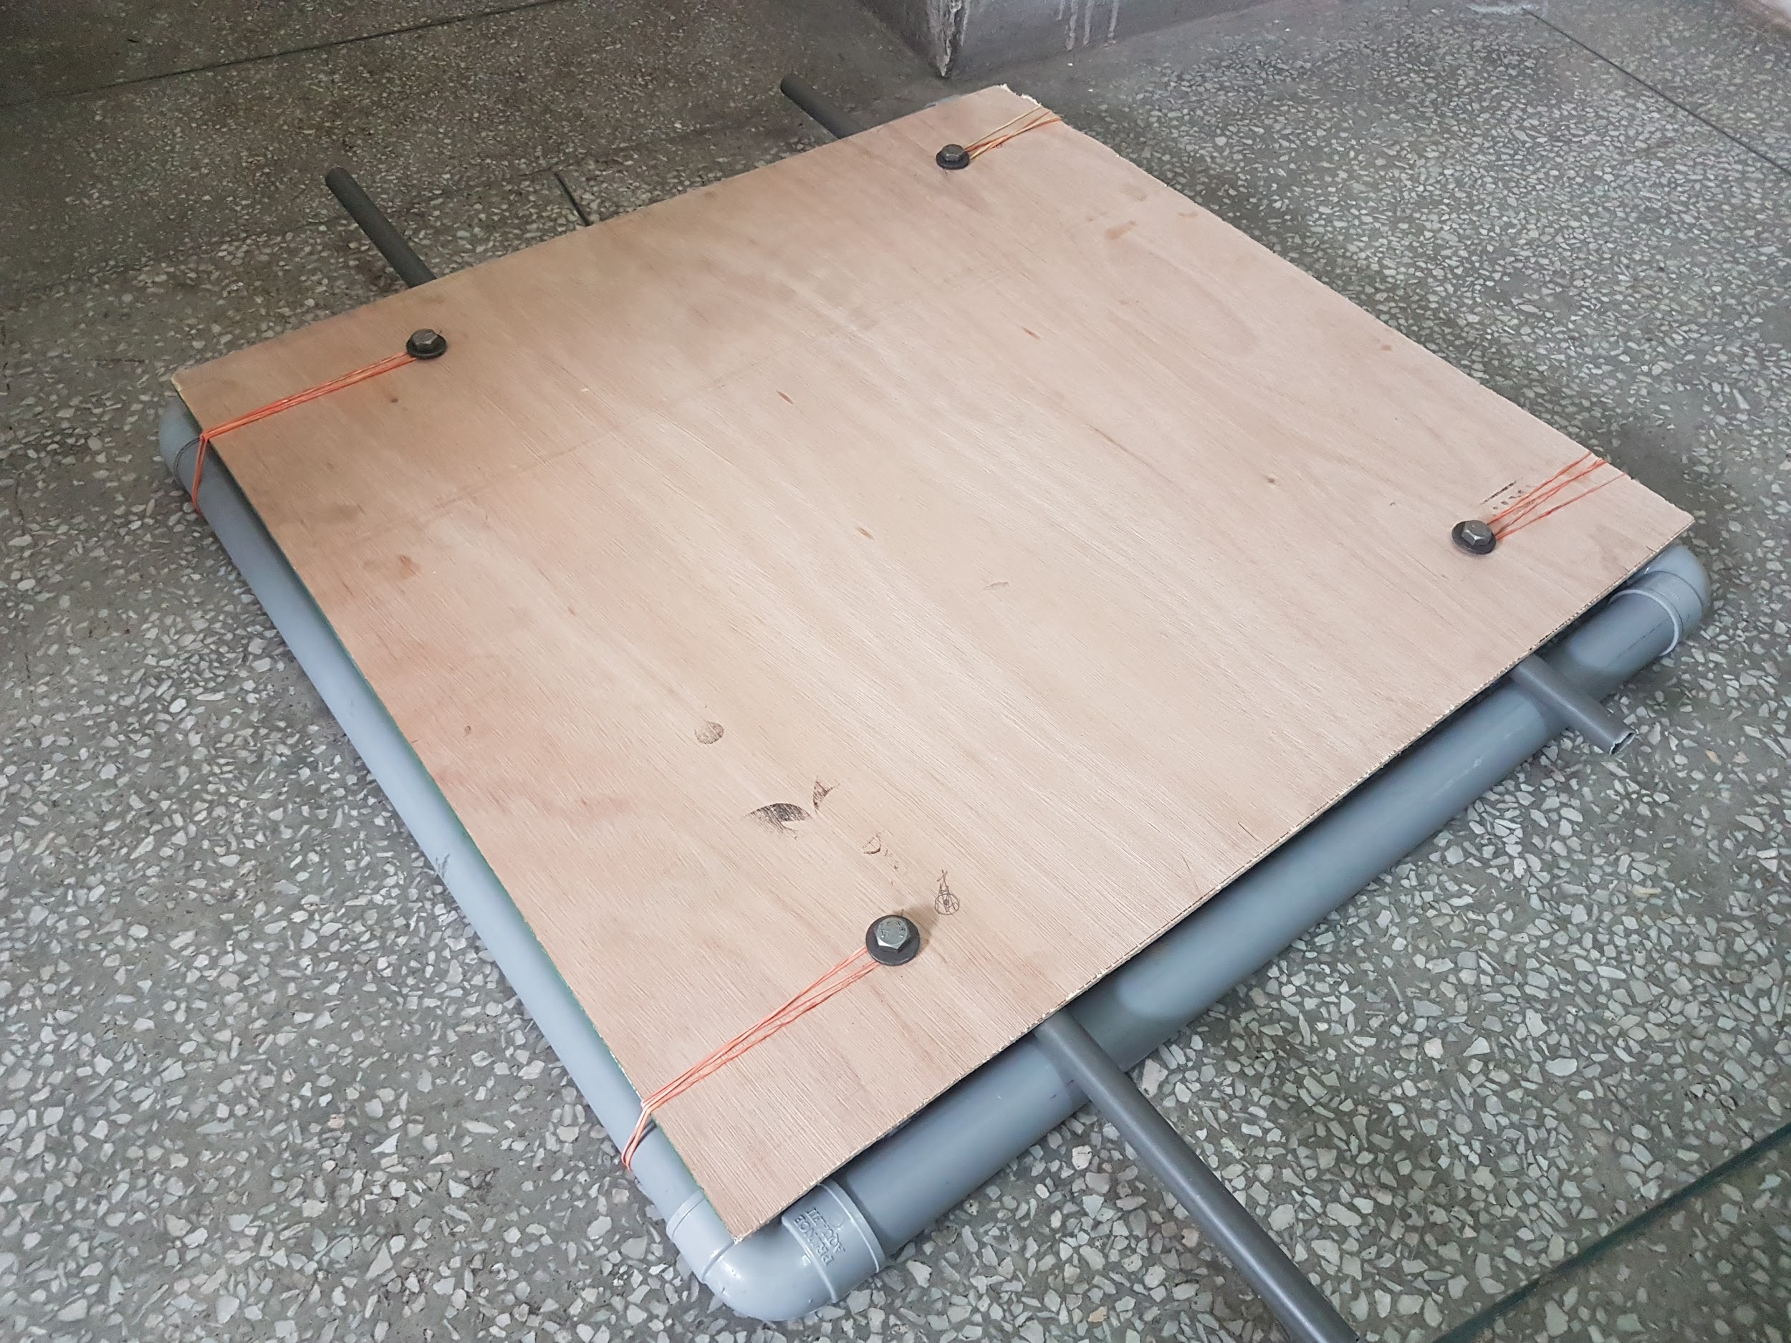
Shake table

Slide 5
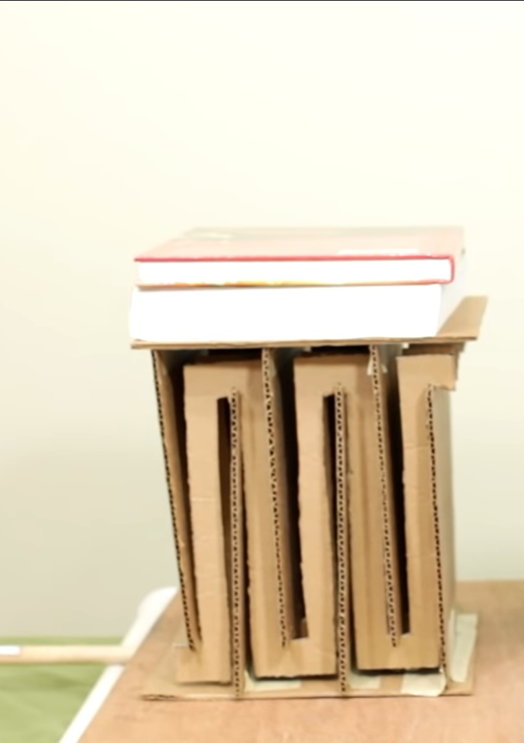

Slide 6
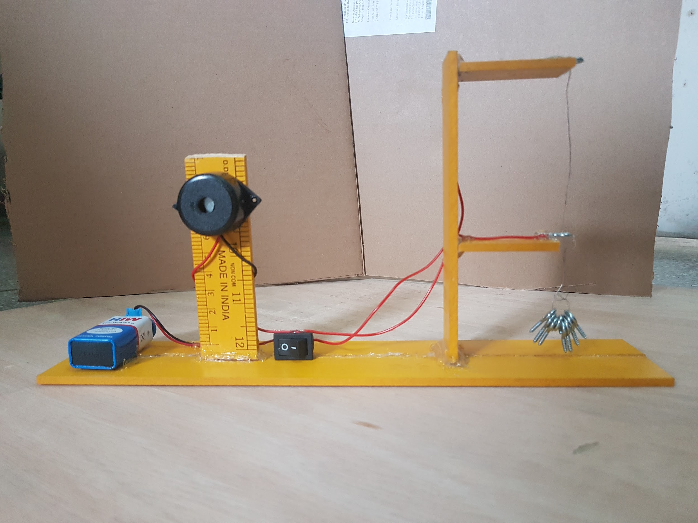
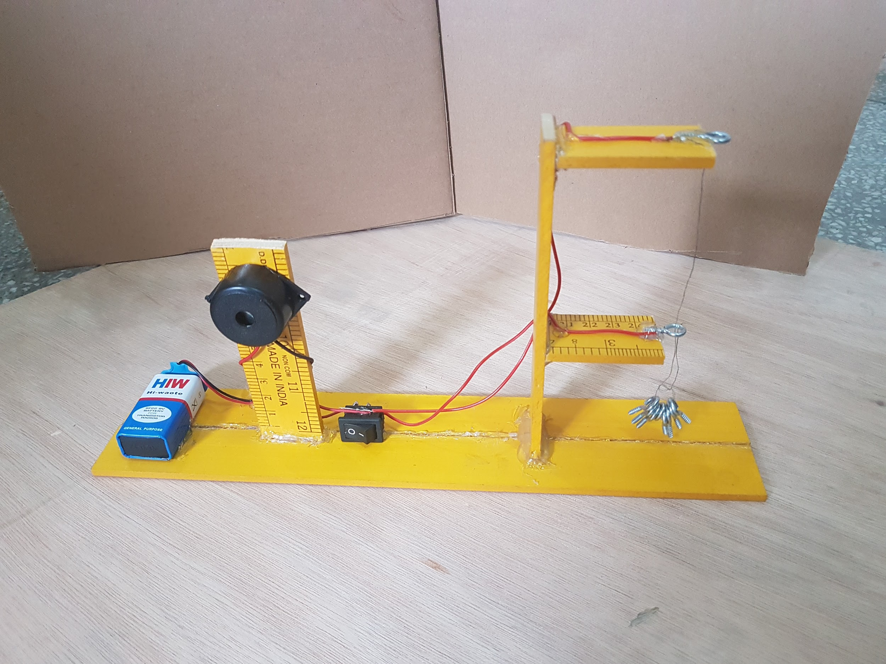
Earthquake alarm

Slide 7
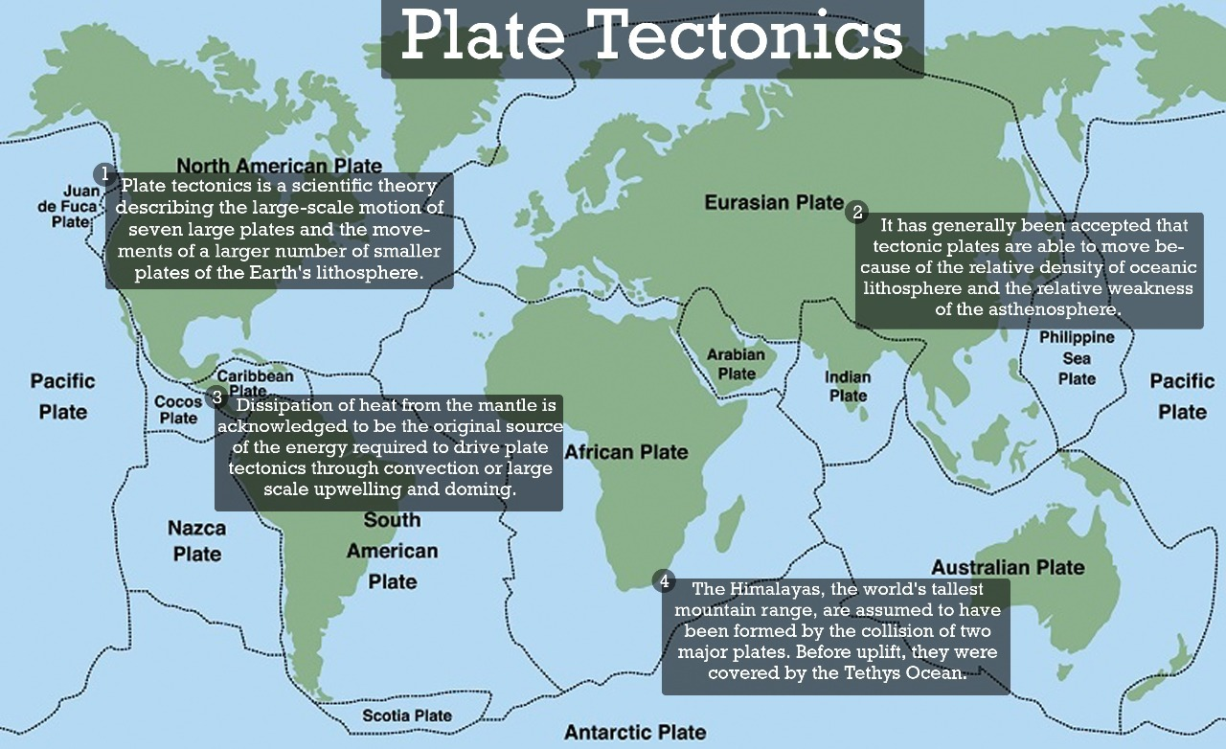
Posters

Slide 8
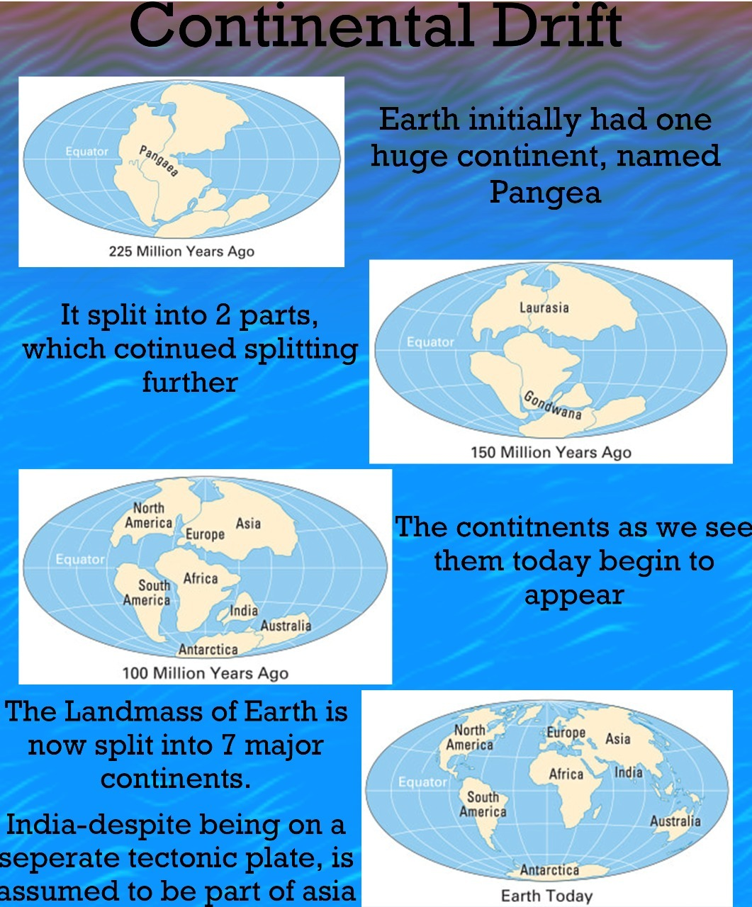

Slide 9
